Slide 1

Coffee Sales Analysis
BY
AZEEZAT AKINYEMI

Slide 2
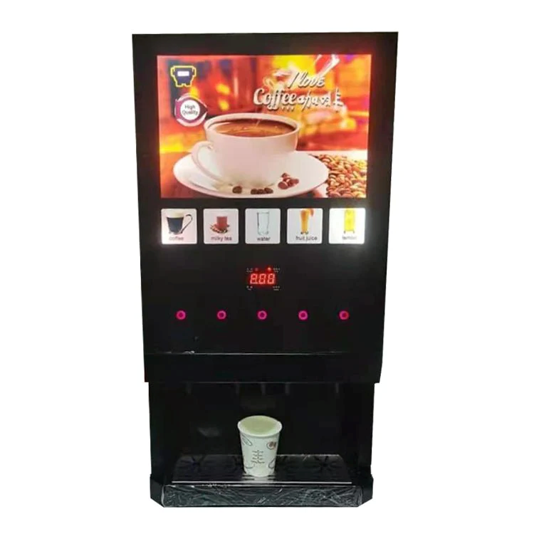
Coffee Sales Analysis
This analysis is based on the detailed records of coffee sales from a vending machine between March 2024 and March 2025.

Slide 3
The Analysis is intended for
Purchasing patterns as per time of the day (Time grouping)
Quarterly sales trend
Customer coffee preferences
Customer payment reference

Slide 4
Purchasing patterns as per time of the day (Time grouping)
Insight
Increased staffing for both evening and afternoon sales
Ensure machines are in good order for smooth daily operation
Help in stocking management
Recommendation
Increase staffing towards afternoons and evenings

Slide 5
Quarterly sales trend
Insight
Coffee sale more during quarter 1 and quarter 4
Customers tend to buy coffee more during winter season
Recommendation
Staffing and other resources should be increased during winter period

Slide 6
Customer payment preference
Insight
Customers prefer card payment to cash
Recommendation
Provide additional POS to reduce waiting time

